Slide 1
Hidden Markov Models
~ Rushali Chopra
26.06.2023
Notes:
A very warm welcome to my presentation today .

Slide 2
Contents :
Markov Chains
Hidden Markov Models
Viterbi Algorithm
Application of HMMs in bioinformatics
Limitations
Take home message
Notes:
We will be discussing these topics throughout the presentation .
Limitations we encounter along the way

Slide 3
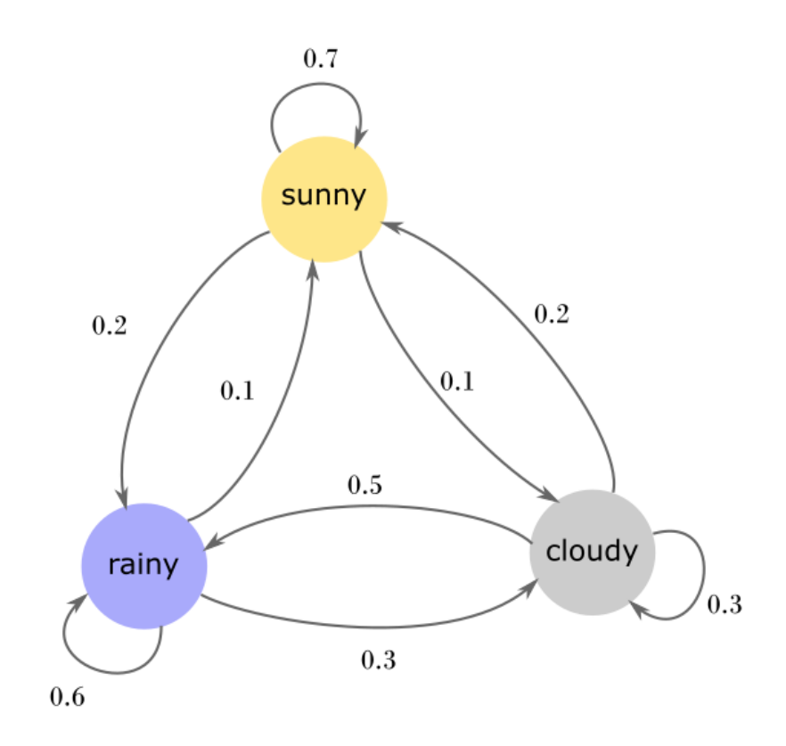
Markov Chains
Stochastic process but it is memory-less
Sequence of states
Markov Property
[1]
[1] https://brilliant.org/wiki/markov-chains/
Notes:
Stochastic process - when a random variable changes over period of time
Markov chain describes seq of events where the prob of transitioning to future state depends only on the current state.

Slide 4
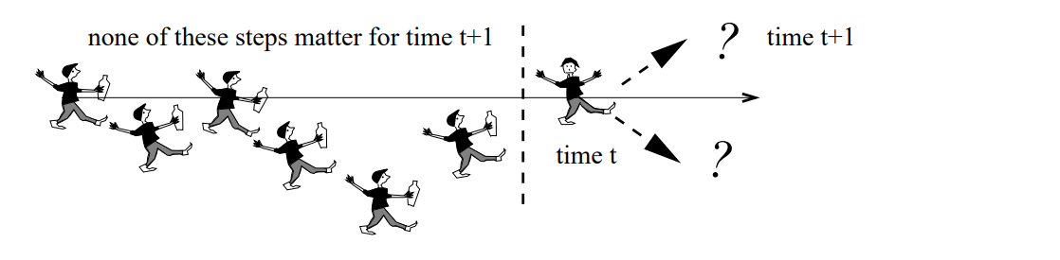
Markov Property
[2]
Notes:
Mr john

Slide 5
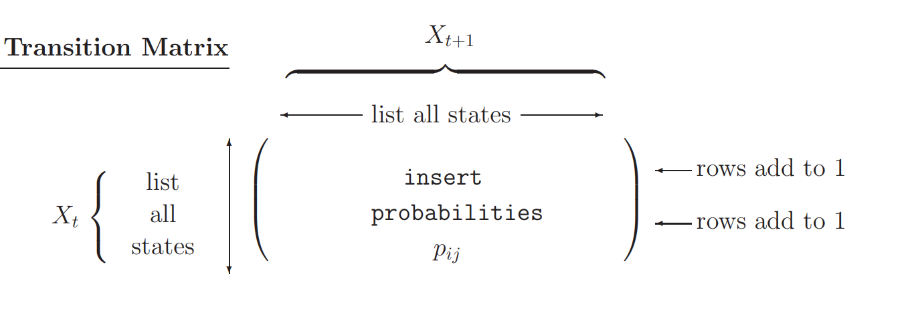

[3]
[2],[3],[4] https://www.stat.auckland.ac.nz/~fewster/325/notes/ch8.pdf

Slide 6
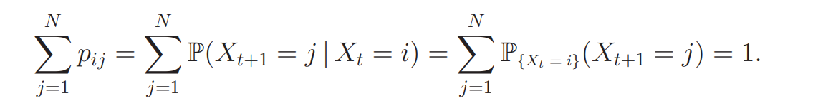
Square matrix (n * n )
Rows sums up to 1 which means X_t+1 takes values from the states available.
[5]
[2],[3],[4],[5] https://www.stat.auckland.ac.nz/~fewster/325/notes/ch8.pdf
Notes:
https://www.stat.auckland.ac.nz/~fewster/325/notes/ch8.pdf

Slide 7
Three classic HMM problems
1. Evaluation: given a model and an output sequence, what is the probability that the model generated that output?
2. Learning: given a model and a set of observed sequences, how do we set the model’s parameters so that it has a high probability of generating those sequences?
3. Decoding: given a model and an output sequence, what is the most likely State sequence through the model that generated the output?
Slide from Markus List
Notes:
Slide from markus list

Slide 8
Algorithms in use :
Evaluation - Forward Backward
Learning - Baum-Welch
Decoding - Viterbi Algorithm

Slide 9

Hidden States - Cold or hot day
Observable States - Ice Cream cones eaten
Transition probability - Hot to cold or vice versa
Emission probability - Observing specific outputs
https://www.etsy.com/de/listing/1396994388/susse-eistute-3?gpla=1&gao=1&&utm_source=google&utm_medium=cpc&utm_campaign=shopping_de_de_de_e-paper_and_party_supplies-paper-stickers_labels_and_tags-other&utm_custom1=_k_Cj0KCQjwy9-kBhCHARIsAHpBjHiJzDSstIYR6Ipq8iMmprCu_rjgz-NToLL21Ksu1rs5Uj9P8XGe2nYaAgfHEALw_wcB_k_&utm_content=go_316422289_18240489049_63996083329_pla-316241129264_c__1396994388dede_102852917&utm_custom2=316422289&gclid=Cj0KCQjwy9-kBhCHARIsAHpBjHiJzDSstIYR6Ipq8iMmprCu_rjgz-NToLL21Ksu1rs5Uj9P8XGe2nYaAgfHEALw_wcB
Notes:
Tom and Tim example

Slide 10
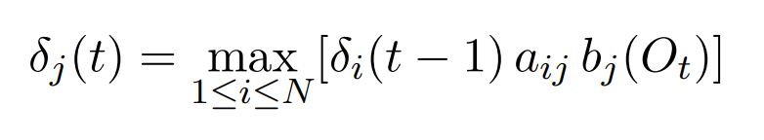
DECODING :- Viterbi Algorithm
Uses Trellis to compute probabilities
Time Complexity is O(N^2 T)
[6]
[6] https://www.cl.cam.ac.uk/teaching/1718/MLRD/slides/slides9.pdf
Notes:
Finding the most likely hodden state seq via dynamic programming
Product of tp to current state q times Ol that this output was generated by state q

Slide 11


Intuition behind Viterbi :
Calculating probability of reaching each state once for each time step.
Then memoise this probability in a Dynamic Programming table.
Effort reduced from to

Slide 12
[7]
aij : the transition probability from si to sj.
bj (O_t): the probability of emitting Ot from destination state sj.
[6][7] https://www.cl.cam.ac.uk/teaching/1718/MLRD/slides/slides9.pdf

Slide 13
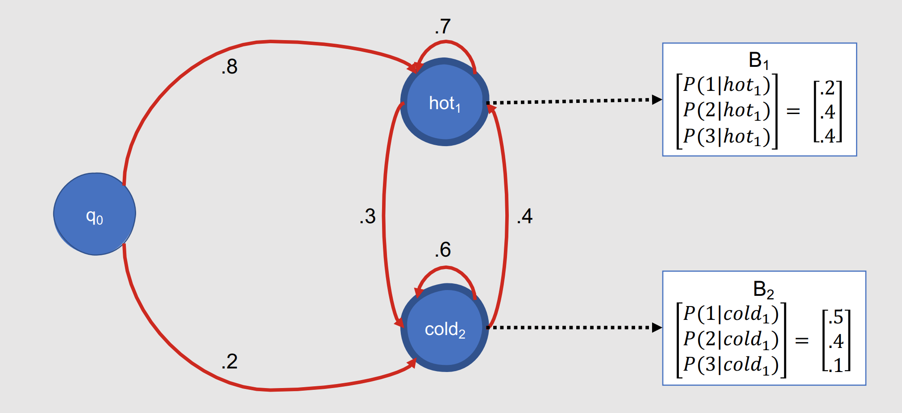
https://www.youtube.com/watch?v=Xh3mf9O5SL0

Slide 14
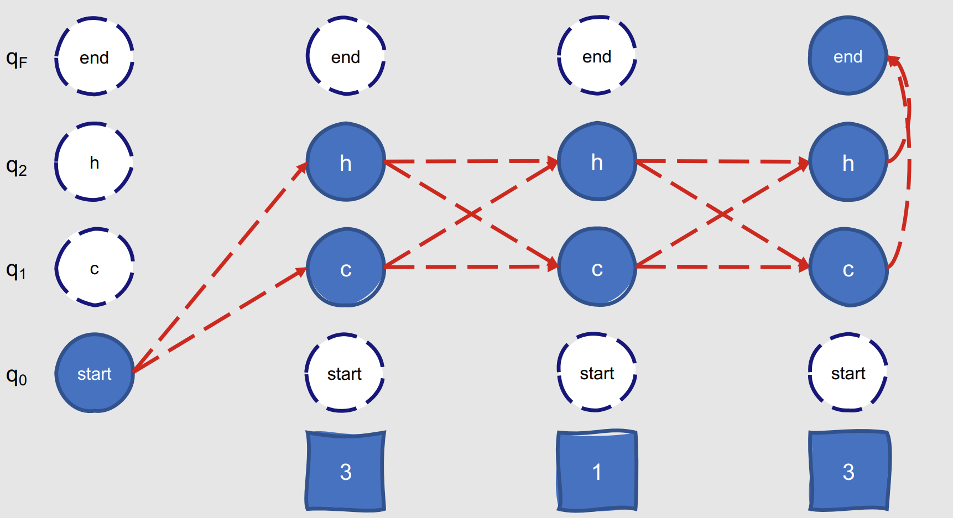

Slide 15
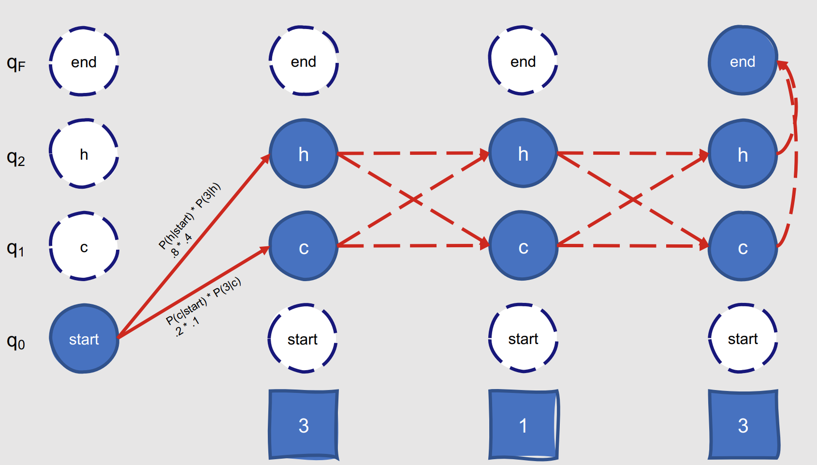

Slide 16
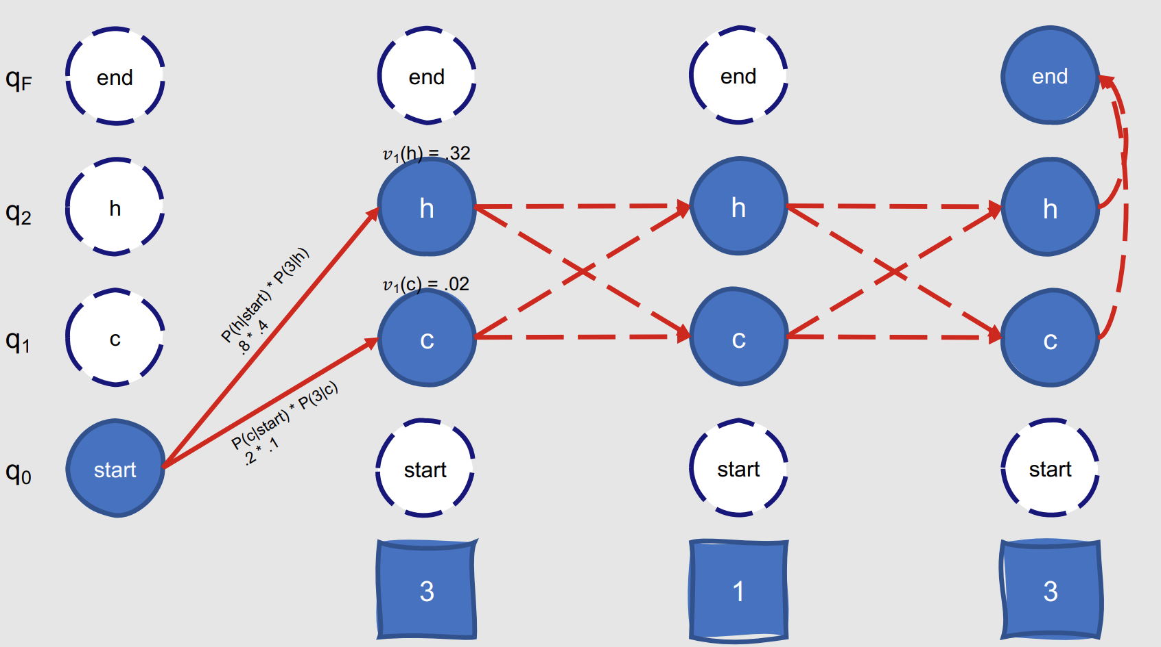

Slide 17
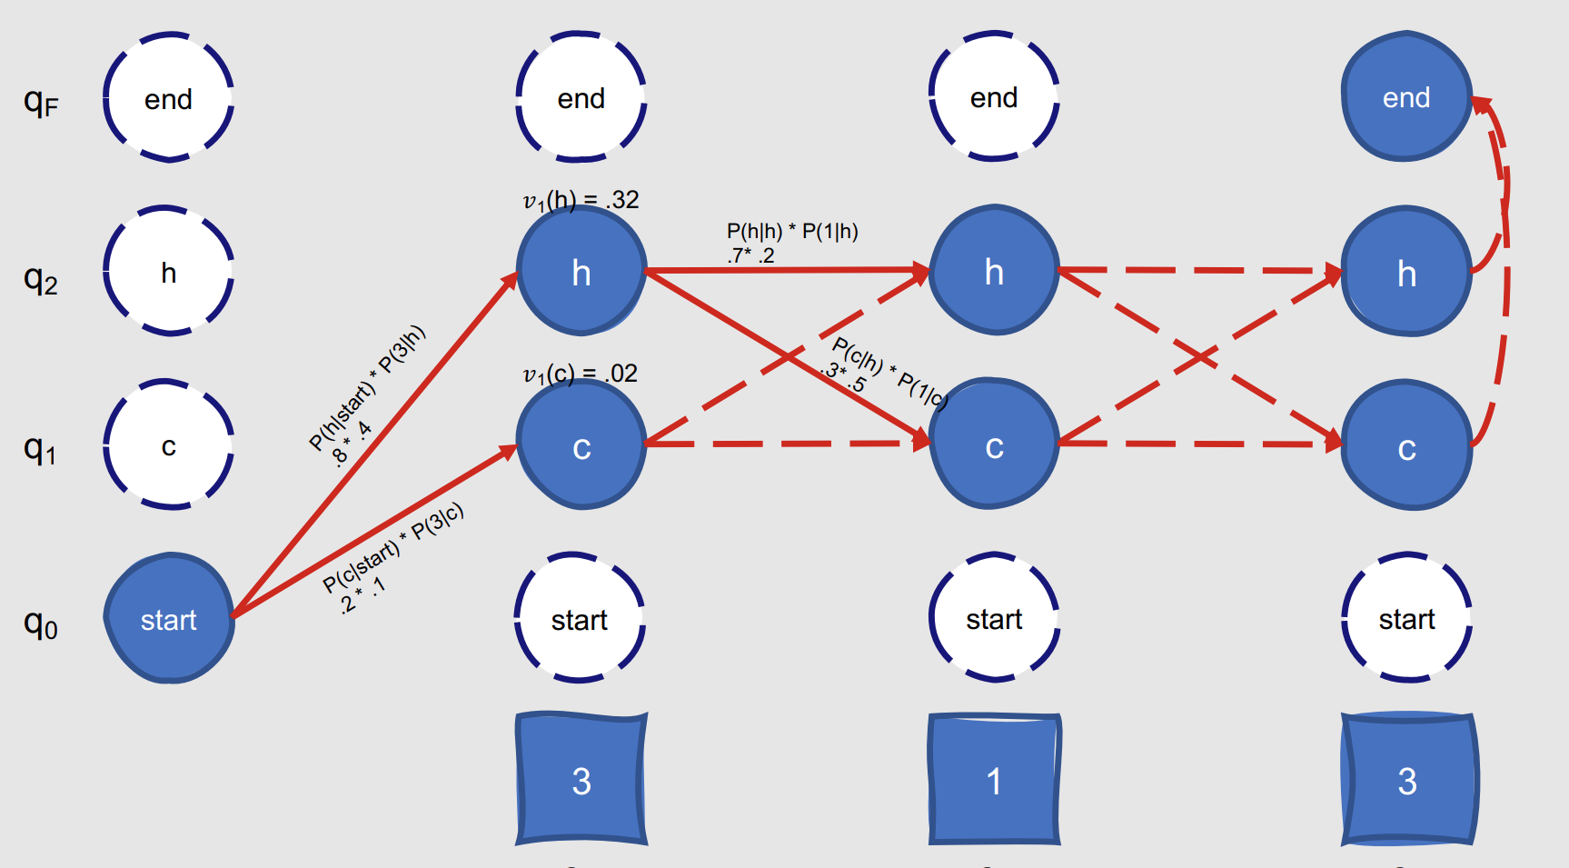

Slide 18
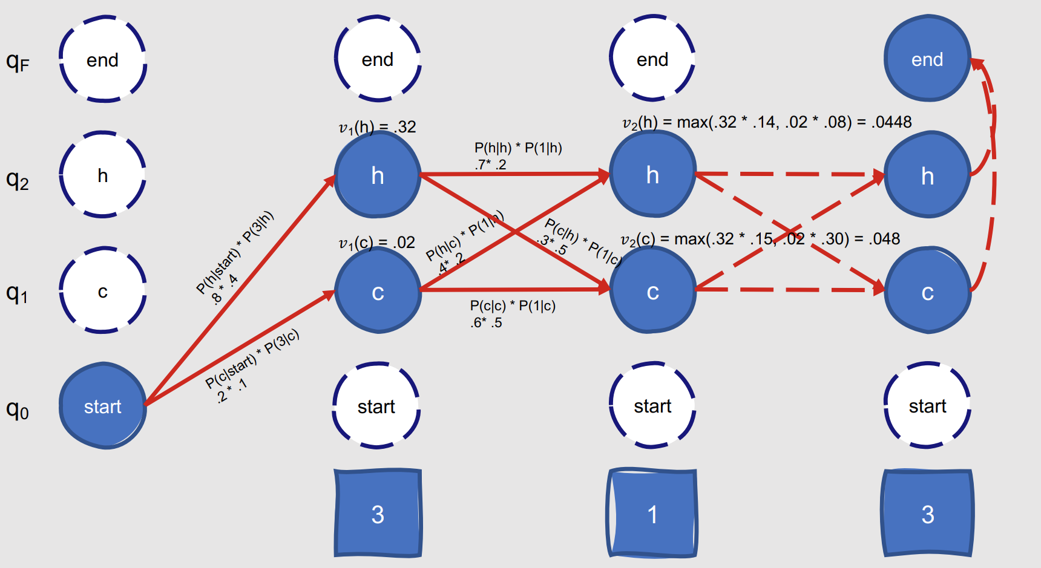

Slide 19
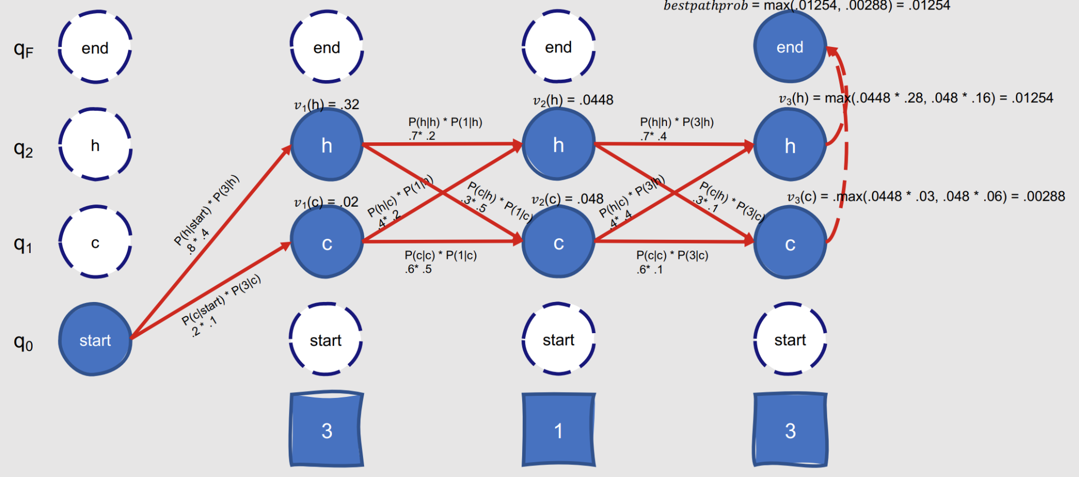

Slide 20
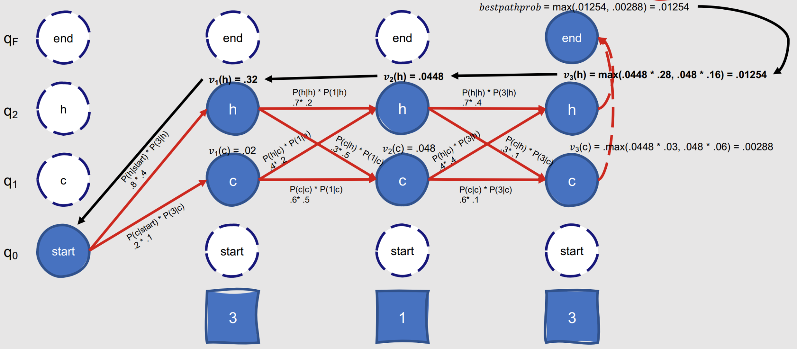
V_2(c) = .048

Slide 21
Applications
Gene prediction
Protein family classification
Multiple sequence alignment
Protein structure prediction
RNA structure prediction
Sequence motif discovery
Protein domain identification
Molecular evolution

Slide 22
What’s new ?
Structural bioinformatics ( protein folding pathways, protein structure-function relationships)
Cancer genomics (analyze genomic alterations and identify driver mutations associated with tumor progression)
Epigenomics(identifying specific epigenetic marks, such as DNA methylation patterns or histone modifications, and their functional roles in gene regulation)

Slide 23
Common limitations of HMMs:
Model training and its complexity(EM used is computationally intensive and sensitive to initialization)
Complexity in Handling Large State Spaces(computational complexity increases with increasing no. of states.
Fixed model structure (predefined no. of states & transitions , but the real world is different)

Slide 24
What did you learn so far ?
Wide application in Bioinformatics
Markov Property
Sequential data analysis
Viterbi algorithm
Notes:
The prob that you all understood is 1 , why bcz it is biased Structural bioinformatics (predict protein folding pathways, protein structure-function relationships) Cancer genomics (analyze genomic alterations and identify driver mutations associated with tumor progression) Epigenomics(identifying specific epigenetic marks, such as DNA methylation patterns or histone modifications, and their functional roles in gene regulation)

Slide 25
Thanks for your attention !
Any Questions?

